Slide 1
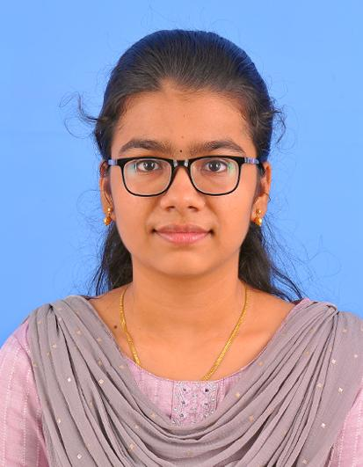
Divya N - 2312014
Career Objectives | Motivated Full Stack Developer seeking to leverage expertise in front-end and back-end technologies to create impactful web applications.
Specialization Chosen | Full Stack Development
NPTEL – Completed | Technical English, The joy of computing using python
NPTEL – Planned | Cloud computing(on going), Introduction to Industry 4.0 and Industrial Internet of Things(on going)
Internship – Completed | Nil
Internship – Planned | Turning
Participation – Online Course | Great learning(UI/UX beginners) , NPTEL , Flipkart GRid 6.0
Participation – Workshop | Nil
Intra college participation | Paper presentation (Neuralink)at BIT, paper presentation (Automatic Bus scheduling and route management)at Sri Ramakrishna Engineering College
Participation – Contest/Expo | Tata imagination Challenge,Flipkart Grid 6.0,Rebel Foods
Achievement – Awards/Reward Certification/Contest won | Paper presentation at Bannari Amman Institute of Technology(Runner)

Slide 2
Skillrack details
Medal count:364
Rank:22674
No of programs solved:863
Daily challenges:7
Daily Tests:5
Code test:16
Code tracks:628
Code tutorial:163
Aptitude:1078
Languages wise count
C -631
Python -98
C++ - 103
SQL- 31

Slide 3
Divya N - 2312014
Communication Skills | Moderate
Competency required | Proficiency in full stack development frameworks and team collaboration.
Present Competency | Creative Thinking
Gap in Competency | Leadership and decision making
Plan for Filling Gap | Doing Hands-on projects

Slide 4
Divya N - 2312014
Electives Planned
IV Semester | Linear Structures and Transformations
V Semester | No SQL database Advanced JAVA programming
VI Semester | UI/UX design Flutter and firebase
VII Semester | Node JS Full stack application development
VIII Semester | Mobile application development

